Slide 1


Elo Merchant Category Recommendation
Understand More about the Customer Loyalty
@SHAN KWAN CHO
Notes:
ELO wants to offer the promotions/ offer to their card holders.

Slide 2
What is ELO ?
ELO, a large payment brand in Brazil.
ELO has partnerships with many merchants (Business Partner).
What business development does ELO take action?
ELO wants to offer promotions or discounts to cardholders
ELO wants to know that promotions work for either consumer or merchants and cares about customer experiences and Personalized Promotions.
Notes:
ELO Brazilian payments company, developed
algorithms to offer personalized promotions and discounts to consumers and helped business partners to drive economic growth.
Right now, Elo, one of the largest payment brands in Brazil, has built partnerships with merchants in order to offer promotions or discounts to cardholders. But do these promotions work for either the consumer or the merchant? Do customers enjoy their experience? Do merchants see repeat business? Personalization is key.

Slide 3
ELO > Machine Learning Model > Lifecycle
> Kaggle Competition
ELO has built Machine Learning Models to understand the most important aspects and preferences in their customers’ lifecycle (i.e groceries, cloth, food, etc)
However, there is no yet categorized specifically for an individual or profile.
ELO create Kaggle Competition and award with $5000 to solve ELO business problems .
Notes:
so far none of them is specifically tailored for an individual or profile. This is where you come in.

Slide 4

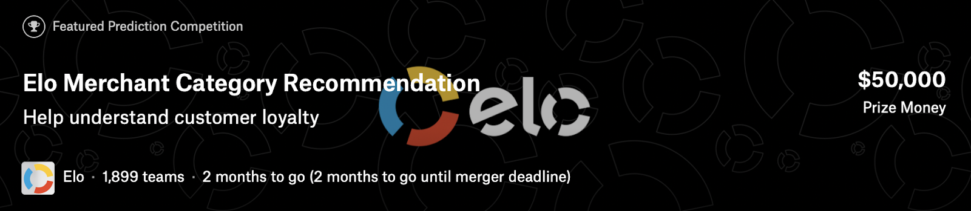

Slide 5
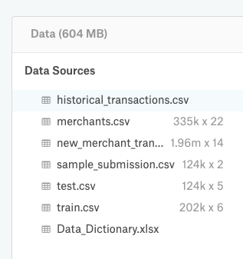
Obtain Data
Kaggle provides the data under data folders
Historical_transactions - include up to 3 months’
worth of historical transactions for each card_id
Merchants - additional information about all
merchants
New_merchant_transactions - two months’ worth
of data for each ID containing all purchases that
ID made at merchant_ID (not visited in Historical
Data ) over period of two months
Train / Test / sample_submission
Note: .csv format
Notes:
What files do I need?
You will need, at a minimum, the train.csv and test.csv files. These contain the card_ids that we'll be using for training and prediction.
The historical_transactions.csv and new_merchant_transactions.csv files contain information about each card's transactions.historical_transactions.csv contains up to 3 months' worth of transactions for every card at any of the provided merchant_ids.new_merchant_transactions.csv contains the transactions at new merchants (merchant_ids that this particular card_id has not yet visited) over a period of two months.
merchants.csv contains aggregate information for each merchant_id represented in the data set.
What should I expect the data format to be?
The data is formatted as follows:
train.csv and test.csv contain card_ids and information about the card itself - the first month the card was active, etc. train.csv also contains the target.
historical_transactions.csv and new_merchant_transactions.csv are designed to be joined with train.csv, test.csv, and merchants.csv. They contain information about transactions for each card, as described above.
merchants can be joined with the transaction sets to provide additional merchant-level information.
What am I predicting?
You are predicting a loyalty score for each card_id represented in test.csv and sample_submission.csv.
File descriptions
train.csv - the training set
test.csv - the test set
sample_submission.csv - a sample submission file in the correct format - contains all card_ids you are expected to predict for.
historical_transactions.csv - up to 3 months' worth of historical transactions for each card_id
merchants.csv - additional information about all merchants / merchant_ids in the dataset.
new_merchant_transactions.csv - two months' worth of data for each card_id containing ALL purchases that card_id made at merchant_ids that were not visited in the historical data.
Data fields
Data field descriptions are provided in Data Dictionary.xlsx.

Slide 6
Main Strategies
Join the two broad transaction.csv (historical and new_merchant ) and
Focus on the particular period of time < Assumption >
Google Colab platform runs out of memory size ; solution came up with reducing memory size using reduce_mem_usage user defined function
Filled all the missing values in Historical and New_merchant data.

Slide 7
Main Evaluation Strategies
Features extraction for Historical and New_merchant data
Purchase Date, Authorized Flag columns from historical and new_merchant data
Calculated sum, min, max, variance from the features we extracted
Created new columns for these calculated features, group by them with card_id (submission purpose), merge these columns with train data and test data.
After adding these data into train and test, deleted historical and new_merchant.
Outliers
Added a new column in training data set for outliers
Assigned 1 to the outliers that are below -30, otherwise 0.
Trained the Light GBM (Gradient Boosting Method) model with stratified k-fold with 5 folds, draw feature_importances and calculated root mean square errors.
Notes:
ELO MERCHANT CATEGORY RECOMMENDATION
• Participated in a Kaggle Competition that focused on helping ELO, a Brazilian payments company, developed
algorithms to offer personalized promotions and discounts to consumers and helped business partners to drive
economic growth.
• Sampled and merged business data from different sources, performed pre-processing on the aggregated data,
and conducted feature engineering to remove outliers, performed categorical embedding, and extracted new
features.
• Built LightGBM and CatBoost models, applied stratifiedKFold for model optimization, and generated predictions
of customer loyalty metric, landing in the top 16% of the competition.
Utilized: Numpy, Pandas, TimeSeries, Scikit-Learn, Lightgbm, Catboost

Slide 8

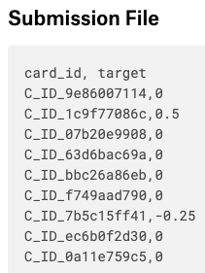
Root Mean Square Error (RMSE)
Kaggle requires submission with y_target as predicted loyalty score for
each card_id
RMSE is defined as :\\\
Note: This is one of the main evaluations that
provided from Kaggle

Slide 9
Tuning Hyper-parameters and Comparisons
Training with the Light GBM (Gradient Boosting Method) of stratified KFolds cross-validator
params = {'boosting': 'gbdt', ( to tune the hyper-parameters)
'objective':'regression',
'metric': 'rmse',
'learning_rate': 0.01, # 0.003! #0.005 #0.006
'num_leaves': 110, #110 #100 #150 large, but over-fitting
'max_bin': 66, #60 #50 # large,but slower,over-fitting
'max_depth': 10, # deal with over-fitting
'min_data_in_leaf': 30, # deal with over-fitting
'min_child_samples': 20,
'feature_fraction': 0.5, #0.5 #0.6 #0.8
'bagging_fraction': 0.8,
'bagging_freq': 40,#5
'bagging_seed': 11,
'lambda_l1': 2, #1.3! #5 #1.2 #
'lambda_l2': 0.1 #0.1
}

Slide 10
Limitation and Results Comparison
Trials | Early_stopping _rounds | fold | max_depth | Loss error | Rank on Kaggle
1 | 200 | 5 | Default -1 | 3.6542
2 | 200 | 10 | Default -1 | 3.6514
3 | 100 | 10 | Default -1 | 3.6526
4 | 100 | 5 | 6 (trick) | 3.650 (better ) | 425 / 1850
5 | 200 | 5 | 6 | 3.6504

Slide 11
Limitation and Results Comparison - Continue:
Trials | Early_stopping _rounds | fold | max_depth | Loss error | Rank on Kaggle
6 | 100 | 10 | 6 | 3.6488 (best result so far)
7 | 300 | 10 | 6 | 3.6505
8 | 100 | 5 | 6 | 3.650536 | Note: Verbose_Eval = 20, Verbose_Eval = 500, 100
 |  |  |  |  | Each testing took 20 ~ 25 mins

Slide 12
In Progress . . .
CATBoost Algorithm works a bit better Validation which is 3.6280198
(Just did use CATBoost model implemented which score higher
( in this case lower due to RMSE; the lower error, the higher level in Kaggle)
Currently running with the XGBoost with RepeatKFold

Slide 13
What NEXT ????? =>
Trying to manipulate outliers more efficiently from training dataset
Trying to run the model with using categorical features cause it already has built-in categorical feature parameters
Could change to repeated k-fold ( Why not ~ always play around and test it )

Slide 14

Questions and Answers (Q&A)

Slide 15

Thank you ~

